Slide 1
Blockchain Approach to Data Security
Issue in Modern ERP Software
Project By
Maurya Samanta
002211701092
Under the guidance of
Dr. Asim Gopal Barman,
Department of Production Engineering,
Jadavpur University

Slide 2
INDEX
Page
I
Introduction
3
II
Methodology
5
III
Literature Review
6
IV
Problem Identification
9
V
Solution
10
VI
Discussion
11
VII
Roadmap to Development
12
VIII
Example Flow
13
IX
Conclusion
14
X
References
15

Slide 3
INTRODUCTION
Enterprise Resource Planning (ERP) systems are integral to modern business operations, especially in industries like manufacturing, where seamless coordination of processes such as procurement, inventory management, production, and sales is critical.
Despite their potential, ERP systems face significant challenges, including:
High implementation and maintenance costs.
Integration difficulties with legacy systems and custom workflows.
Vulnerabilities to data security threats.
These limitations often prevent businesses, particularly (Small and Medium Enterprises) SMEs, from realizing the full benefits of ERP systems.

Slide 4
METHODLOGY
The research utilized a comprehensive approach to investigate ERP challenges and potential solutions in the manufacturing sector:
Literature Review:
Conducted an extensive review of articles, and journals to gather existing knowledge.
Keywords such as “ERP challenges”, “manufacturing sector”, “system integration” and “employee resistance” were used to retrieve relevant publications.
Sources included databases like ResearchGate, Google Scholar, and industry reports.
After going through the papers and gaining necessary insights, applied knowledge in software development to propose an architecture and roadmap for the development of an ERP System using Blockchain

Slide 5
LITERATURE REVIEW
“Moving ERP Systems to the Cloud-Data Security Issues” Pablo Saa, Andrés Cueva Costales, Oswaldo Moscoso-Zea, Sergio Lujan-Mora
Authors pointed out the differences and benefits of Cloud-Based ERP over On-Premise ERP Systems.
Explained how companies are reluctant to move to Cloud-Based ERP systems because of data security issues as they feel that they do not have direct control over their data.
The second main concern is maintaining integrity of data in cloud-based systems as data can be lost because of cloud providers’ fault and errors.
The paper fails to provide an actual long-term solution to the data security issue.
“A Critical Review of ERP Systems Implementation in Multinational Corporations: Trends, Challenges, and Future Directions” Glory Ugochi Ebirim Ifeyinwa Francisca Unigwe
Depicted the implementation of AI and ML in the various modules of ERP enhancing decision making.
Stated that User Acceptance and Data Security concerns are the biggest roadblocks in implementing ERP Systems in organizations.
Recommended the use of Blockchain Technology to solve data security and integrity issue.
Failed to provide a proper technical roadmap for development and implementation of such blockchain technology.

Slide 6
“Challenges of ERP Systems in Manufacturing Sector: A comprehensive analysis” Mahboob Al Bashar Md Abu Taher Fatema Tuz Johura
Thoroughly explained Technical, Financial and Organizational problems associated with ERP Systems with data gathered from surveys.
Legacy systems used by manufacturing firms are difficult to integrate with modern ERP Systems.
The intial investment expenses are a huge burden especially for Small and Medium Enterprises. Furthermore, continuous upgrade charges increase the financial strain.
Organizational challenges include employee resistance to change and fear of job displacement.
“A Model of Cloud-Based Enterprise Resource Planning (ERP) for Small and Medium Enterprise” Mohammad Jahangir Alam, Shoman Das Sharma, Tanjia Chowdhury
Stated how Small and Medium Enterprises benefit from cloud-based ERP Systems as set up costs are minimal
Provided a roadmap for implementation of ERP System.
Provided necessary solution to high cost problem by promoting cloud-based architecture but failed to address Data security and integrity concerns.

Slide 7
“ERP with Blockchain” Oliver Bodemer
Thoroughly explored the practical implementation of Blockchain in ERP Systems and the challenges involved with it through case studies.
Showed that the integration of Blockchain will not only enhance data security and integrity but also bring about significant operational efficiencies.
Discussed the technical complexities associated with blockchain, related to system integration, ensuring data consistency across the blockchain network, and managing the change in organizational processes and workflows.
The study did not provide the technical roadmap for developing such a system.

Slide 8
PROBLEM IDENTIFICATION
01
Centralized Nature
Single Point of Failure
03
02
Lack of Transparency
04
Data Integrity Issues
BREACH IN SECUTRITY
DISRUPT OPERATIONS
DAMAGE REPUTATION

Slide 9

SOLUTION
Integrating Blockchain with ERP Systems to create a secure, transparent, and tamper-proof environment for critical business data.
1
Decentralized Data Storage
2
Enhanced Security
3
Transparency

Slide 10
DISCUSSION
Understanding Blockchain
Definition:
Blockchain is a digital ledger of transactions that is distributed across multiple computers (nodes) in a network.
Think of it as a secure, unchangeable spreadsheet shared among a group, where everyone can see changes but no one can alter past entries.
Key Features:
Decentralized: Data is not stored in one central location but across a network.
Immutable: Once data is recorded, it cannot be altered without consensus from the network.
Transparent: All participants can see the history of recorded data, ensuring trust.

Slide 11
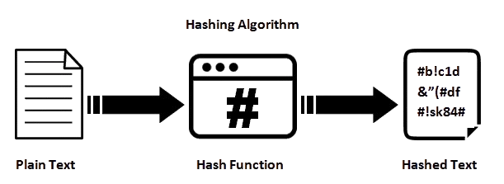
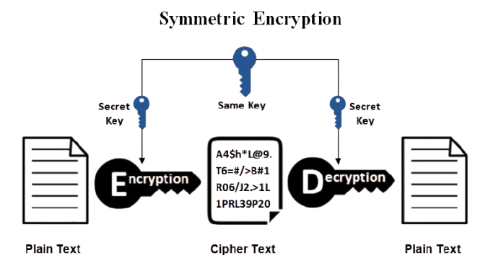
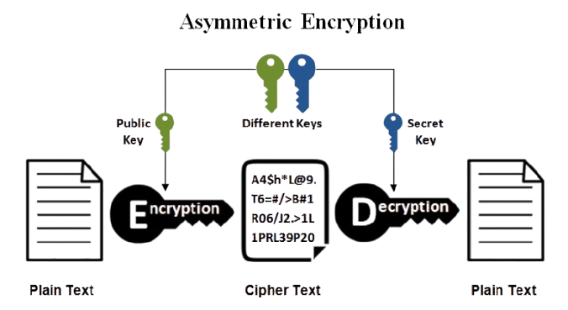
Securing Data with Cryptography

Slide 12
ROADMAP TO DEVELOPMENT
Smart Contracts Module
Backend
Blockchain Network Management
Frontend
Blockchain
Data Anchoring Module
ARCHITECTURE DESIGN
DEVELOPING THE BLOCKCHAIN LAYER
Blockchain API Module
Business Logic Module
Authentication Module
Database Module
BACKEND LAYER
MIDDLEWARE LAYER
Dashboard Module
Unit Tests
Transaction Management Module
Integration Tests
Reporting Module
CI/CD Module
FRONTEND LAYER
TESTING LAYER

Slide 13
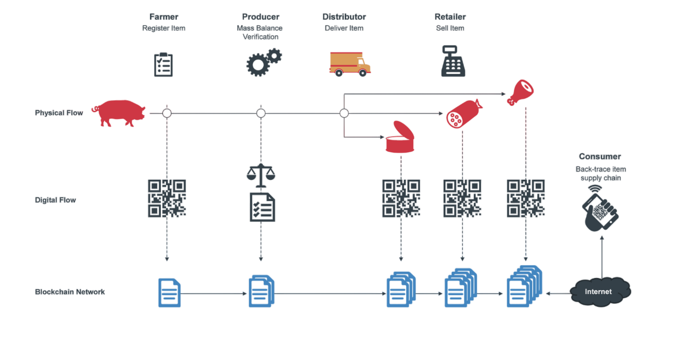
EXAMPLE FLOW

Slide 14
CONCLUSION
Summary of Findings:
Integrating ERP software in the manufacturing industry significantly improves operational efficiency but faces challenges such as data security concerns, high costs, integration issues, and workforce resistance.
Contributions of the Study:
This study addresses the critical issue of data security in cloud-based ERP systems by proposing the use of decentralized blockchain technology.
Solution: Implementing ERP on a blockchain enhances security, transparency, and efficiency across modules like financial transactions, inventory, and supply chain.
Proposed Architecture: A structured design with frontend, backend, and blockchain layers for effective integration.
Future Directions: Encourages further development of blockchain-based ERP systems for greater innovation and adoption.

Slide 15
REFERENCES
Alam, M.J., Sharma, S.D. and Chowdhury, T. (2024) A Model of Cloud-Based Enterprise Resource Planning (ERP) for Small and Medium Enterprise. Journal of Computer and Communications, 12, 37-50. https://doi.org/10.4236/jcc.2024.1210004
Arnold Masud Abukari & Vivek Gupta “A Homomorphic Block Approach to Blockchain and Cloud ERP Implementation” Journal of applied Intelligent Systems and Information Sciences 4.1(2023): 55-59
Faccia, A., & Petratos, P. (2021). Blockchain, Enterprise Resource Planning (ERP) and Accounting Information Systems (AIS): Research on e-Procurement and System Integration. Applied Sciences. https://dx.doi.org/10.3390/APP11156792
G. U. Ebirim & I. F. Unigwe “A Critical Review Of ERP Systems Implementation In Multinational Corporations: Trends, Challenges, AND Future Directions” International Journal of Management & Entrepreneurship Research 06.02(2024): 281-295
K. M. Verma & N. D. Chowdary “Cloud based ERP systems and Data Security for Cloud based ERP Applications -SAP S/4HANA.” International Journal of Scientific Research in Engineering and Management (IJSREM) 07.02 (2023)

Slide 16
M. A. Basher & M. A. Taher “Challenges Of ERP Systems In The Manufacturing Sector: A Comprehensive Analysis” International Journal of Progressive Research in Engineering Management and Science (IJPREMS) 04.05(2024): 1858-1866
M. Bolanle & Mark J Keown “Adoption of enterprise resource planning (ERP) systems and cloud-based accounting software” (2024)
M. H. Miraz & H. H. Jin “What factors affect the adoption of cloud-based ERP in companies' operations in Malaysia?” International Journal of Management and Sustainability 13.03(2024): 490-505
Mohanta, B. K., Panda, S. S., & Jena, D. (2018). An Overview of Smart Contract and Use Cases in Blockchain Technology. ICCCNT. https://dx.doi.org/10.1109/ICCCNT.2018.8494045
Oliver Bodemer “Navigating the Uncharted Waters of Integrating Blockchain with Enterprise Resource Planning” (2023)

Slide 17
Pablo Saa & Andres Costales “Moving ERP Systems to the Cloud - Data Security Issues” Journal of Information Systems Engineering 02.04(2017)
T. S. Wulan & P. W. Novika “Impact of ERP System Implementation on Operational and Financial Efficiency in Manufacturing Industry” 05.02 (2024) https://journal.unm.ac.id/index.php/JE3S/index

Slide 18
Thank you
for your
attention

